Slide 1
Delivering a Presentation
Microsoft Powerpoint 2013
Lesson 11

Slide 2
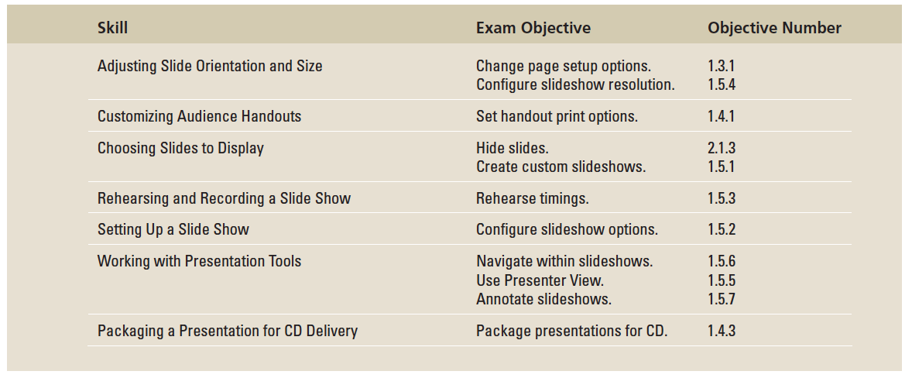
Objectives

Slide 3
Step by Step: Select Slide Size and Orientation
GET READY. Before you begin these steps, make sure that your computer is on. Log on, if necessary.
START PowerPoint, if it is not already running.
Locate and open the Bid presentation and save it as Bid Final.
Click the Design tab, and then click the Slide Size button. A menu opens.
Click Widescreen. The height/width ratio for all slides in the presentation change to widescreen (16:9).

Slide 4
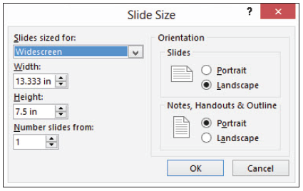
Step by Step: Select Slide Size and Orientation
Click the Slide Size button again, and click Custom Slide Size. The Slide Size dialog box opens (right).
Note the current width and height measurements at the left side of the dialog box.
Open the Slides Sized For drop-down list and examine the available options for slide sizes. Click 35mm Slides, and note the width and height settings.
Notes:
Take Note: The measurements for Width and Height in the Slide Size dialog box are in inches, but an inch on a monitor can look different depending on the monitor’s size and display resolution. The main concern is the ratio between the height and the width here. For example, the ratio of 13.333” [ts] 7.5” expressed as a fraction is 16/9, the standard for widescreen.

Slide 5
Step by Step: Select Slide Size and Orientation
Click Portrait in the Slides area.
Click OK. A dialog box opens asking whether you want to maximize the size of your content or scale it down.
Click Ensure Fit. The slide’s orientation and aspect ratio has changed.
Reopen the Slide Size drop-down list and click Standard (4:3).
When prompted whether you want to maximize or ensure fit of the content, click Maximize.

Slide 6
Step by Step: Select Slide Size and Orientation
The slides return to their original 4:3 dimensions. The content has been somewhat distorted in size due to your choices of Ensure Fit and Maximize in steps 9 and 11 respectively.
SAVE the presentation.
PAUSE. LEAVE PowerPoint open to use in the next exercise.

Slide 7
Step by Step: Customize the Handout Master
USE the Bid Final presentation that is still open from the previous exercise.
Click the Insert tab, click Header & Footer, and click the Notes and Handouts tab.
Set up headers and footers as follows:
a. Click to mark the Date and time check box, and make sure the Update automatically option is selected.
b. Click to mark the Header check box, and type the header A. Datum Corporation.
c. Click to mark the Footer check box, and type the footer No Job Is Too Big for A. Datum.
d. Click Apply to All.
Click the Design tab, click Slide Size, and then click Custom Slide Size.

Slide 8
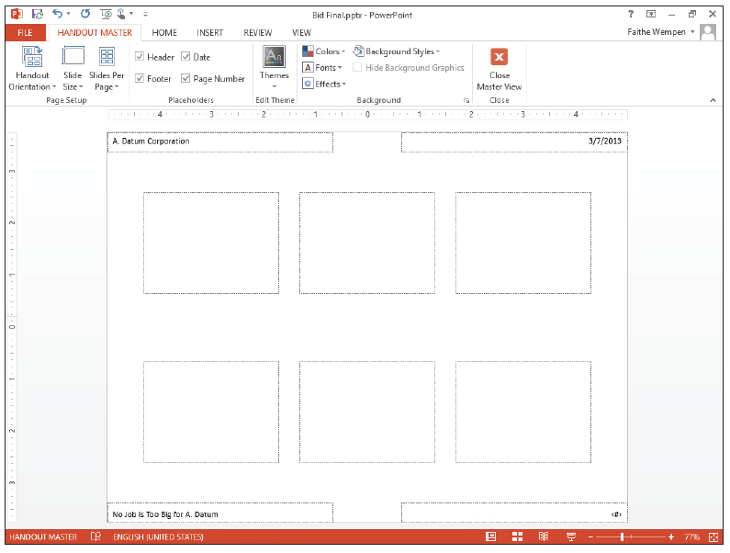
Step by Step: Customize the Handout Master
Under the Notes, Hand- outs & Outline heading, click Landscape, and click OK.
Click the View tab, and then click the Handout Master button in the Presentation Views group. The Handout Master view opens (see the figure at right) with the header and footer you supplied in step 2.
Notes:
Take Note: If the file is stored on a server, you may see a message about edits made in this view being lost when saved to the server. Click Check Out to continue.

Slide 9
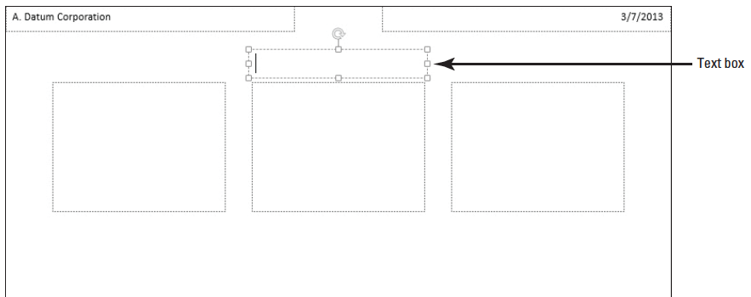
Step by Step: Customize the Handout Master
Click the Slides Per Page button in the Page Setup group, then click 3 Slides. The Handout Master displays the layout used to show three slides across the width of the page.
Click the Insert tab, click Text Box, and draw a text box above the center slide placeholder of the same width as the placeholder (see the figure below).

Slide 10
Step by Step: Customize the Handout Master
Type Center City Bridge Project in the text box.
Change the font size of the text box text to 16, apply bold formatting, change the color to Dark Blue, Text 2, and center the text. Adjust the size of the text box as necessary to display the text on one line.
Click the outside border of the header placeholder in the upper-left corner of the master, hold down Shift, and click the date, footer, and page number placeholders.
Change the font size to 14 pt, apply bold formatting, and change the color to Dark Blue, Text 2.
Click the Handout Master tab, and then click the Close Master View button to exit Handout Master view.

Slide 11
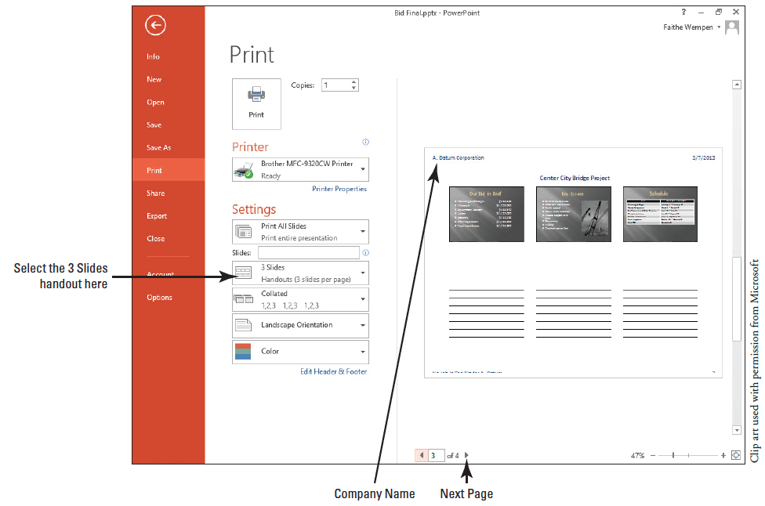
Step by Step: Customize the Handout Master
Click the File tab and click Print. Open the Full Page Slides button’s list and click 3 Slides. Your customized handout master should resemble the one previewed below.

Slide 12
Step by Step: Customize the Handout Master
Click the Next Page arrow to see that the text box you added displays on each page of the handouts.
Click the Print button to print the handouts.
SAVE the presentation.
PAUSE. LEAVE the presentation open to use in the next exercise.
Notes:
Take Note: In some classrooms, printing is limited or unavailable. Check with your instructor as needed to make sure it is okay to print a multiple-page document in your classroom.

Slide 13
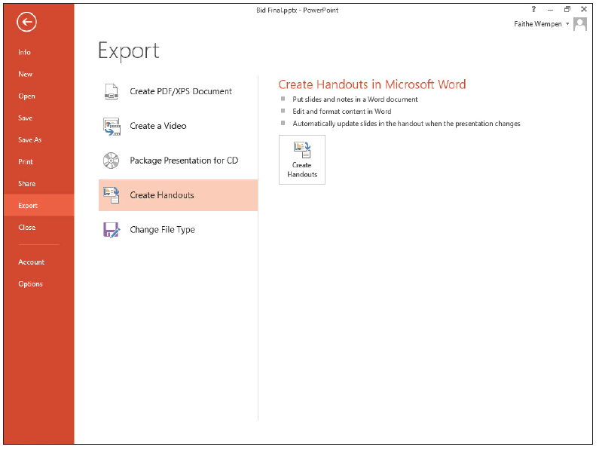
Step by Step: Export Handouts to Word
USE the Bid Final presentation that is still open from the previous exercise.
Click the File tab, click Export, click Create Handouts. and then click the Create Handouts button (see the figure at right). The Send to Microsoft Word dialog box opens.

Slide 14
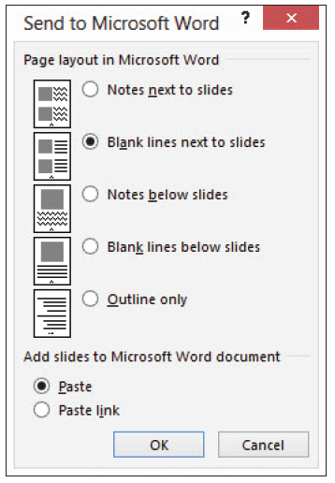
Step by Step: Export Handouts to Word
Click Blank lines next to slides (see the figure at right). Then click OK. Microsoft Word opens and a new document is created containing the handouts.
Click the first slide’s image, and drag its lower-right corner selection handle to decrease the image's size by about 0.25”, so it fits in the cell.

Slide 15
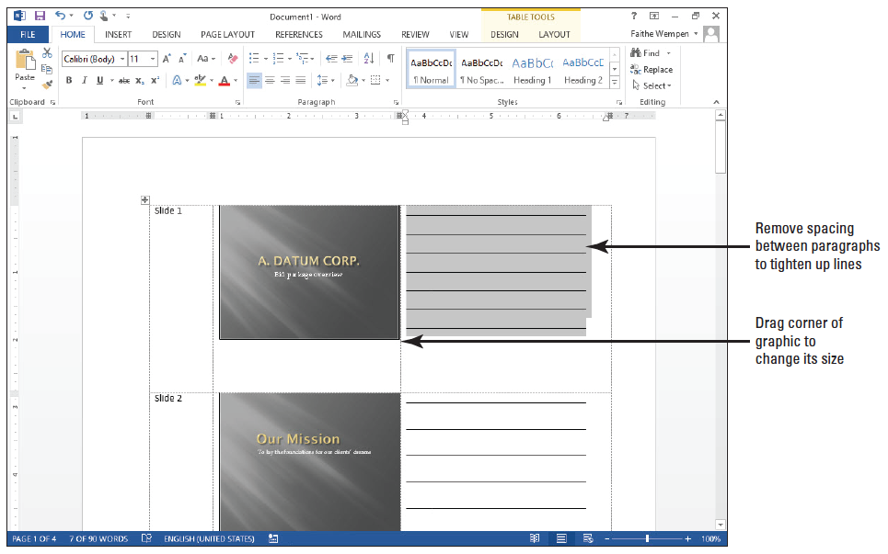
Step by Step: Export Handouts to Word
Drag across the horizontal lines in the first row to select them.
On the Home tab, click the Line and Para- graph Spacing button, and click Remove Space After Paragraph. The spacing between lines tightens up (see figure).

Slide 16
Step by Step: Export Handouts to Word
Repeat the changes from steps 3-5 for each slide.
SAVE the Word document as Handouts.docx and EXIT Word.
PAUSE. LEAVE the Bid Final presentation open to use in the next exercise.

Slide 17
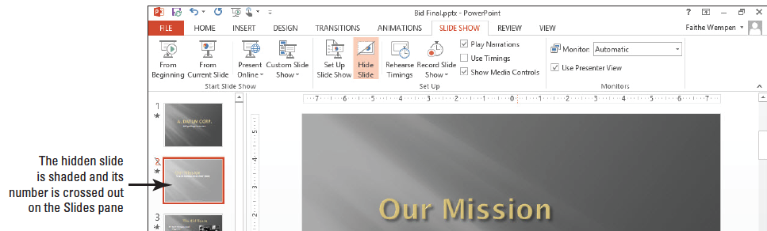
Step by Step: Hide a Slide
USE the Bid Final presentation that is still open.
Go to slide 2, and then click the Slide Show tab.
Click the Hide Slide button in the Set Up group. The slide is shaded in the Slides pane at the left (see below), and the slide number is surrounded by a box with a diagonal bar across it.
Notes:
Another Way: Right-click a slide in the Slides tab or in Slide Sorter view, and click Hide Slide on the shortcut menu.

Slide 18
Step by Step: Hide a Slide
Press F5 to start the presentation from slide 1.
Click the mouse button and notice that slide 2, Our Mission, does not display—you go directly to slide 3, The Bid Team.
Press Esc to stop the slide show.
PAUSE. LEAVE the presentation open to use in the next exercise.

Slide 19
Step by Step: Create a Custom Show
USE the Bid Final presentation that is still open from the previous exercise.
Click the Slide Show tab, if necessary, and then click the Custom Slide Show button in the Start Slide Show group.
Click Custom Shows. The Custom Shows dialog box opens.
Click the New button. The Define Custom Show dialog box opens.
In the Slide Show Name box, type Corporate Information.

Slide 20
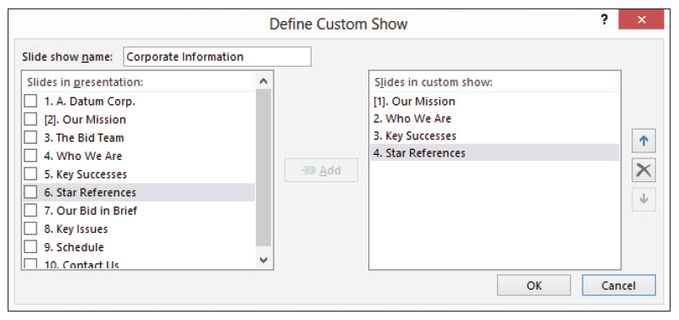
Step by Step: Create a Custom Show
Click the check box for slide 2 in the Slides in presentation list, and then click the Add button to place this slide in the Slides in custom show list.
Add slides 4, 5, and 6 to the custom show list. Your dialog box should look like the figure below.
Notes:
Take Note: The brackets around slide 2’s number indicate it is a hidden slide.

Slide 21
Step by Step: Create a Custom Show
Click OK, and then click Show. The custom show starts with the second slide you added (the first slide, slide 2, is still hidden). If you were to unhide slide 2, it would also be unhidden in this custom show.
Click the mouse button to proceed through the slides of the custom show until the show ends.
SAVE the presentation.
PAUSE. LEAVE the presentation open to use in the next exercise.
Notes:
Take Note: When you add slides to the Slides in custom show list, they are renumbered in the list, but the slide numbers on the slides do not change.

Slide 22
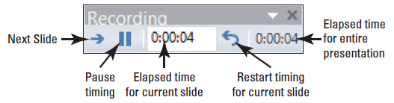
Step by Step: Rehearse and Record Timings
USE the Bid Final presentation that is still open from the previous exercise.
On the Slide Show tab, click the Rehearse Timings button. The slide show starts from slide 1 and the Rehearsal toolbar appears in the upper-left corner of the screen (see the figure below).

Slide 23
Step by Step: Rehearse and Record Timings
Read all the content on each slide, clicking the mouse button to display bullet items and advance slides. As you read, the timer is recording the time you spend. If you get interrupted, you can click the Pause button on the toolbar to pause.
When asked if you want to save the slide timings, click Yes.

Slide 24
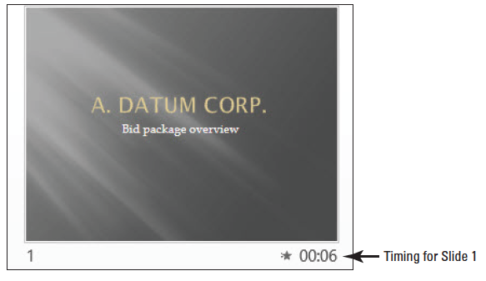
Step by Step: Rehearse and Record Timings
Switch to Slide Sorter view. The presentation appears with the timing for each slide displayed below it (see below).
On the Slide Show tab, mark the Use Timings check box if it is not already marked.

Slide 25
Step by Step: Rehearse and Record Timings
Press F5 to start the slide show again from slide 1. This time, let PowerPoint control the slides according to the rehearsal times you set.
After three or four slides have displayed, press Esc to end the slide show. Switch to Normal view.
SAVE the presentation.
PAUSE. LEAVE the presentation open to use in the next exercise.

Slide 26
Step by Step: Adjust a Slide’s Timing
USE the presentation that is still open from the previous exercise.
Click the Transitions tab.
Select the slide for which you want to change the timing.
Click the up or down arrows in the After box in the Timing group, to incrementally adjust the number of seconds up or down (see the figure on the next slide).
PAUSE. LEAVE the presentation open to use in the next exercise.

Slide 27
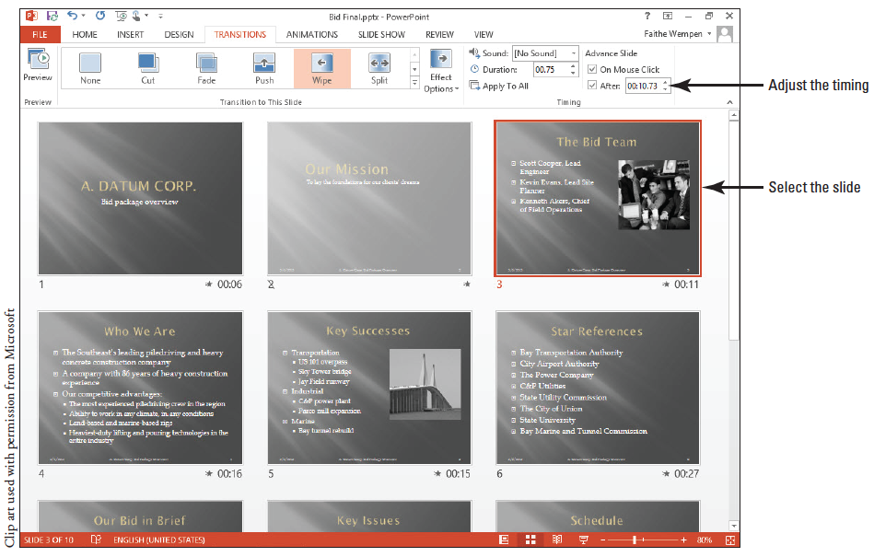
Step by Step: Adjust a Slide’s Timing

Slide 28
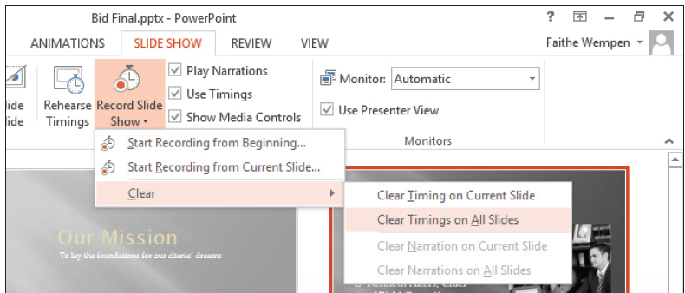
Step by Step: Clear Slide Timings
USE the pre- sentation that is still open.
Click the Slide Show tab.
Click the arrow below the Record Slide Show button to open a menu, point to Clear, and click Clear Timings on All Slides (see below).
SAVE the presentation.
PAUSE. LEAVE the presentation open to use in the next exercise.
Notes:
Another Way: You can also turn off all the automatic transitions by clearing the After check box on the Transitions tab and then clicking Apply to All, or by deselecting the Use Timings check box on the Slide Show tab. However, this does not remove the timings; it just disables their ability to execute automatically. You could later re-enable timings for all slides and have your previously set timings back.

Slide 29
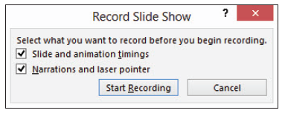
Step by Step: Record a Presentation from the Beginning
USE the presentation that is still open from the previous exercise.
On the Slide Show tab, click the Record Slide Show button. The Record Slide Show dialog box opens (see the figure below).
Make sure your microphone is ready.

Slide 30
Step by Step: Record a Presentation from the Beginning
Click OK to begin the recording.
Click through the presentation, reading the text of the slides into the microphone at a moderate pace. The Rehearsal toolbar appears as you work through the presentation, the same as when rehearsing timings.
When you reach the end of the presentation, click one more time to return to Normal view.
PAUSE. LEAVE the presentation open to use in the next exercise.
Notes:
Take Note: If you flub the narration when recording, keep going. You can re-record individual slides after you are finished.

Slide 31
Step by Step: Record a Presentation from the Current Slide
If you make a mistake in recording a certain slide, you can re-record it.
USE the presentation that is still open from the previous exercise.
Display slide 8.
On the Slide Show tab, click the arrow under the Record Slide Show button and click Start Recording from Current Slide. The Record Slide Show dialog box opens.

Slide 32
Step by Step: Record a Presentation from the Current Slide
Click Start Recording.
Click to advance the bullet points on slide 8 at a moderate speed, while reading the text for slide 8 into the microphone.
Instead of advancing to the next slide, press Esc to quit recording. PowerPoint returns to Normal view.
PAUSE. LEAVE the presentation open to use in the next exercise.

Slide 33
Step by Step: Set Up a Slide Show
USE the Bid Final presentation that is still open from the previous exercise.
SAVE the presentation as Bid Kiosk.
On the Slide Show tab, click Set Up Slide Show. The Set Up Show dialog box opens.
Examine the settings in the Show Type section, but do not make a change yet.
In the Show Options section, mark the Loop continuously until ‘Esc’ check box.
Notes:
Take Note: This setting is turned on automatically if you choose Browsed at a kiosk (full screen) as the show type.

Slide 34
Step by Step: Set Up a Slide Show
Click to mark the Show without narration check box.
Click to mark the Show without animation check box.
Click the Pen Color button, and click the purple standard color.
In the Advance Slides section, click the Use timings, if present option button.
In the Show Type section, click Browsed at a kiosk (full screen).
Notes:
Take Note: The pen color is not important for this presentation because it will be self-running, but it is useful for future reference to know how to change it.

Slide 35
Step by Step: Set Up a Slide Show
Several settings become unavailable when you choose this option, including Loop Continuously Until ‘Esc’ (which becomes permanently on) and Pen Color. That is why this exercise does not change the show type until after you have tried out those settings.
In the Show Slides section, click the Custom Show option button.
In the Multiple Monitors section, open the Slide Show Monitor drop-down list and click Primary Monitor. The Resolution drop-down list becomes available.
Notes:
Take Note: The Corporate Information custom show is automatically selected because it is the only custom show in the presentation.

Slide 36
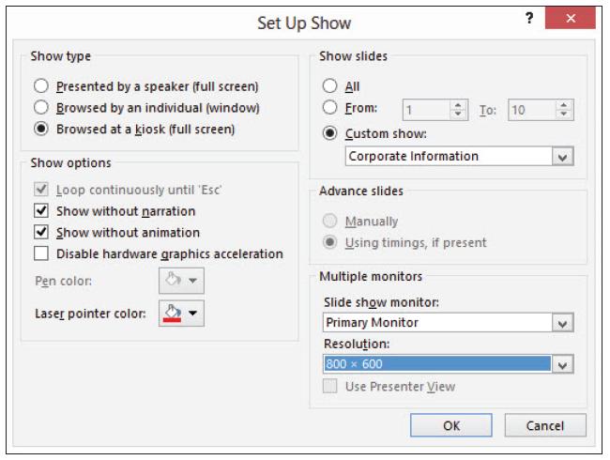
Step by Step: Set Up a Slide Show
Open the Resolution drop-down list and click 800 x 600. The dialog box should look like the figure below.
Click OK. The dialog box closes.
Examine the check boxes in the Set Up group on the Slide Show tab.
Notice that the Play Narrations check box is cleared because of the check box you marked in step 5.
Notice the Use Timings check box is marked because of the option you chose in step 8.
Notes:
Take Note: If you have multiple monitors, the controls in the Multiple Monitors section will be available. With multiple monitors, you can mark the Show Presenter View check box, so that one monitor displays presenter controls (including speaker notes) and the other monitor displays the slides in full-screen mode.

Slide 37
Step by Step: Set Up a Slide Show
Clear the Show Media Controls check box.
This setting is not directly applicable to this presentation because it has no video or audio clips in it. However, knowing how to turn on/off the onscreen controls for such clips is useful for future reference. This setting was also covered in Lesson 9.
SAVE the presentation.
PAUSE. LEAVE the presentation file open to use in the next exercise.

Slide 38
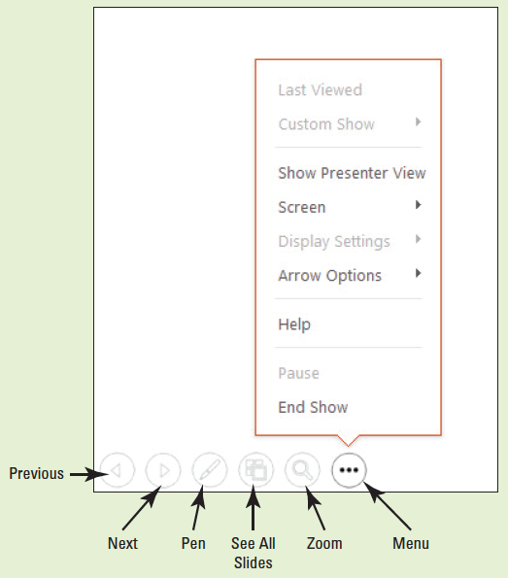
Software Orientation
When in Slide Show view, presentation tools appear in the bottom left corner of the screen. They are faint until you point at them; then they become bright icons that you can click to open menus. In the figure at right, the Menu button is active and its menu is open.

Slide 39
Software Orientation
You can also display a navigation menu by right-clicking anywhere on the slide. The right-click menu contains an additional command, Pointer Options, which opens the same menu as the Pen button in the presentation tools.
If you have a second monitor available, you can optionally choose to display Presenter View on the monitor that the audience does not see. Presenter View contains many tools for controlling the presentation behind-the-scenes, and provides a quick look at any speaker notes you may have included in the presentation file (see the figure on the next slide).

Slide 40
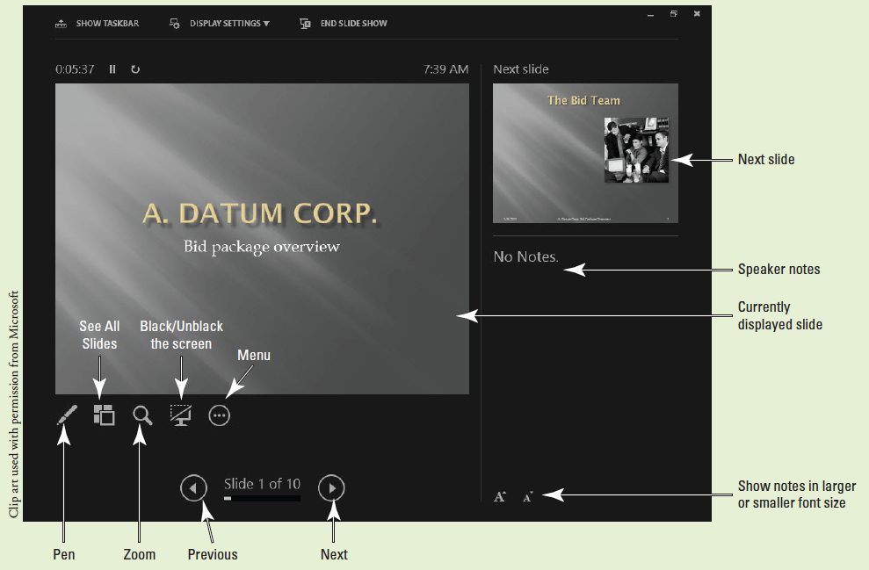
Software Orientation

Slide 41
Step by Step: Move through a Presentation
REOPEN the Bid Final presentation you worked with earlier in this lesson.
Make the following changes to the presentation’s setup so that it is configured to be used by a live speaker:
a. Click the Slide Show tab, click the down arrow under the Record Slide Show button, point to Clear, and click Clear Timings on All Slides.
b. Click the down arrow under the Record Slide Show button, point to Clear, and click Clear Narrations on All Slides.
Notes:
Take Note: An easy way to reopen Bid Final is: click the File tab, click Recent, and click the Bid Final file at the top of the list of recent files.

Slide 42
Step by Step: Move through a Presentation
c. Click the Set Up Slide Show button, and in the Show Slides section, make sure All is selected (not Custom Show).
d. In the Show Type section, click Presented by a speaker (full screen).
e. Open the Slide Show Monitor drop-down list and click Automatic.
f. Click OK.
Click the From Beginning button to start the presentation from slide 1.
Notes:
Another Way: You can also start the presentation from the beginning by pressing F5.

Slide 43
Step by Step: Move through a Presentation
Move the pointer on the slide until you can see the presentation tools in the lower-left corner of the screen (see the figure on slide 38).
Click the Next button (the right-pointing arrow at the far right of the tools). The next slide displays.

Slide 44
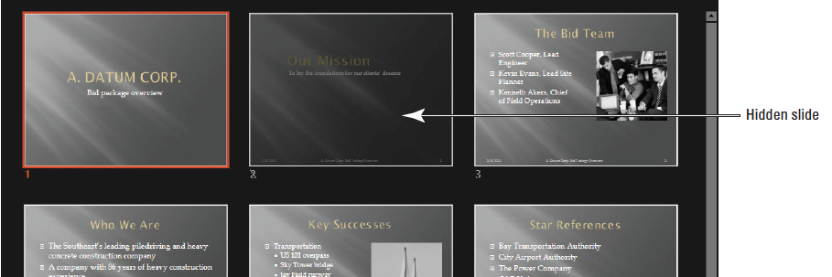
Step by Step: Move through a Presentation
Click the Previous button (the left-pointing arrow at the far left of the tools). Slide 1 redisplays.
Right-click anywhere on the slide to display the presentation shortcut menu, and click See All Slides. Thumbnail images of the slides appear. Notice that slide 2 is darker than the others because it is hidden (see the figure below).
Notes:
Another Way: To go to the next slide if it is hidden, you can press H.

Slide 45
Step by Step: Move through a Presentation
Press Page Down to display the next slide.
Move the mouse pointer to display the presentation tools, and then click the Zoom button (looks like a magnifying glass). A large rectangular shaded area appears, attached to the mouse pointer.
Move the mouse pointer so the shaded area is over the photo and then click to zoom in on the photo. After looking at the photo, right-click to zoom out again.
Click the Menu button in the presentation tools (the rightmost button) to display a menu), and then click Last Viewed. The slide you previously viewed (slide 2) displays.
Right-click the screen again, then click End Show on the presentation shortcut menu to end the presentation.
Notes:
Another Way: You can also end the show by pressing Esc.

Slide 46
Step by Step: Move through a Presentation
PAUSE. LEAVE the presentation open to use in the next exercise.
As you work with PowerPoint, you will find that you develop a feel for the navigation tools that you find easiest to use.
It is often more efficient, for example, to use keyboard options because they can be quicker than right-clicking and selecting options from shortcut menus.

Slide 47
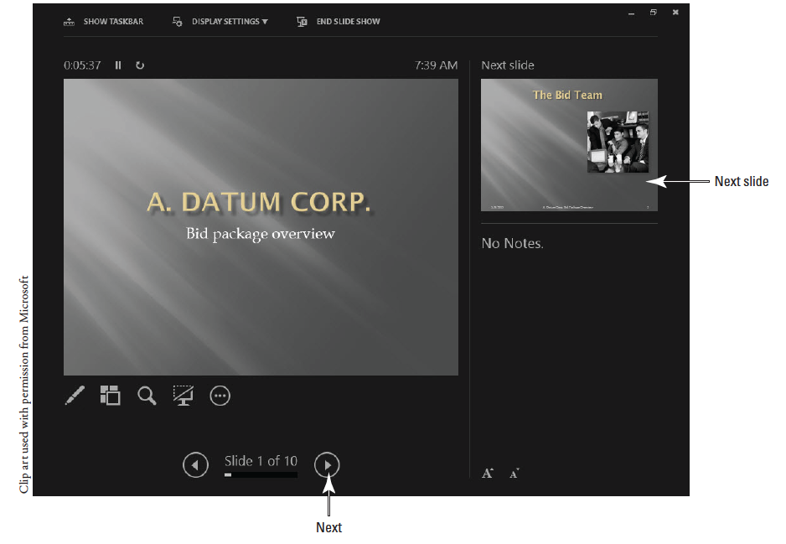
Step by Step: Use Presenter View
USE the present- ation that is still open.
On the Slide Show tab, click From Beginning to start the pre- sentation from slide 1.
Right-click anywhere on the slide and click Show Presenter View on the menu. Presenter view appears (see the figure above).

Slide 48
Step by Step: Use Presenter View
The current slide appears in the large pane on the left. Beneath it are icons that represent some of the same presenter tools as in Slide Show view. These were pointed out in the figure on slide 40. The next slide appears in the smaller pane on the right. If this slide contained any speaker notes, they would appear in the lower right corner.
Click the Next arrow (right-pointing arrow) at the bottom of the screen. The presentation advances to the next slide.

Slide 49
Step by Step: Use Presenter View
Below the notes pane, click the Make the Text Smaller button. The note text appears smaller (see the figure on the next slide).
Above the current slide, note the timer, which has been recording how much time the presentation has been running. Click the Pause the Timer button next to it. The timer stops, and the button turns to a Resume the Timer button (right pointing arrow).

Slide 50
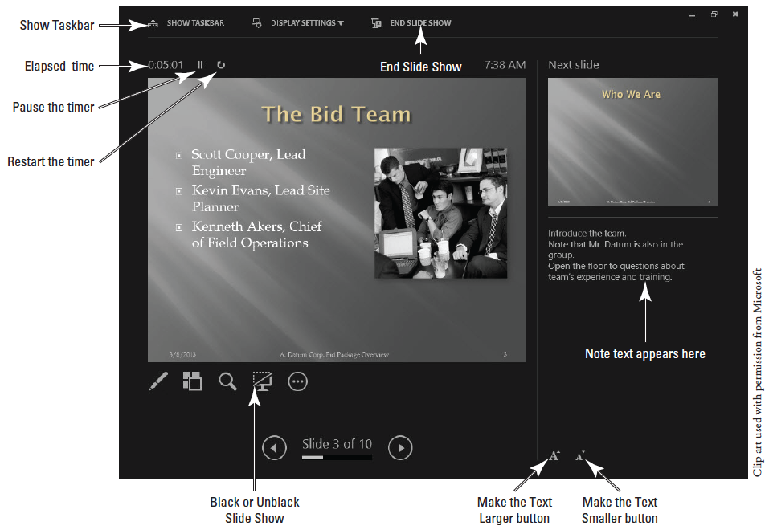
Step by Step: Use Presenter View

Slide 51
Step by Step: Use Presenter View
Click the Restart the Timer button (the button to the right of the Resume the Timer button). The timer resets, and the resumes counting.
Click Show Taskbar. The taskbar appears at the bottom of the screen. Click Show Taskbar again to turn it off. Showing the taskbar during a presentation can be useful because it enables you to jump out to some other application temporarily.
Click the Black or Unblack Slide Show button below the current slide. The image of the current slide appears black, and appears that way on the audience’s screen too.

Slide 52
Step by Step: Use Presenter View
Click the Black or Unblack Slide Show button again to restore the current slide’s image to the audience’s screen.
Click End Slide Show to end the presentation.
PAUSE. LEAVE the presentation open to use in the next exercise.
Notes:
Another Way: You can also black or unblack the screen by pressing B. If you prefer white, use the W key instead.

Slide 53
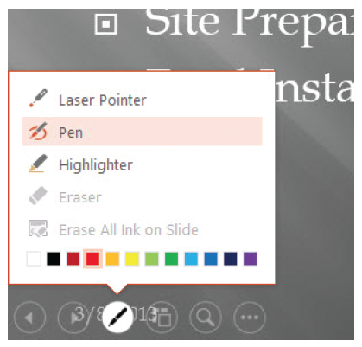
Step by Step: Annotate Slides
USE the Bid Final presentation that is still open from the previous exercise.
Press F5 to start the presentation from slide 1, type 7, and press Enter. Slide 7 appears.
Move the mouse to display the presenter tools, click the Pen icon, and Pen (see the figure at right). The pointer changes to a small, round pen pointer.
Notes:
Another Way: You can also right-click, click Show All Slides, and select slide 7. This lesson uses a variety of navigation methods, for practice.

Slide 54
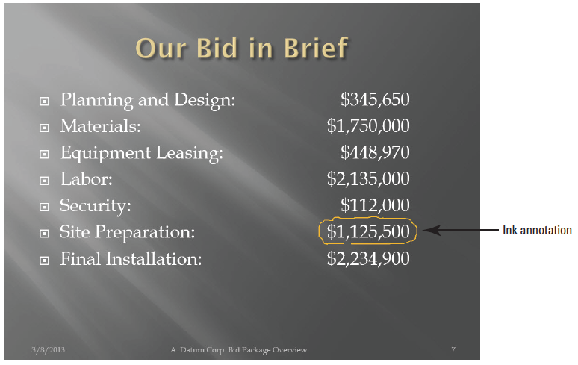
Step by Step: Annotate Slides
Right-click the slide, point to Pointer Options, and click Ink Color. Then click Orange in the Standard Colors palette.
Use the pen pointer to circle the value for site preparation, $1,125,500 (see the figure at right).

Slide 55
Step by Step: Annotate Slides
Press the B key on the keyboard. The screen is blacked out so you can annotate without the distraction of the slide material.
Use the pen pointer to draw a large U.S. currency symbol ($) in the middle of the slide.
Press the B key again. The slide background is restored and the annotation disappears.
Press Esc on the keyboard. The arrow pointer is restored.
Click or press Enter to go to slide 8.
Notes:
Take Note: While a pen pointer is active, you cannot use the mouse button to advance slides.

Slide 56

Step by Step: Annotate Slides
Click the Pen button in the presentation tools, and then click Highlighter. Drag the highlighter pointer across the Weather bullet item to highlight it (see below).
Click the Pen button, and then click Erase All Ink on Slide. The highlight you added is removed.
Notes:
Another Way: You can also press E to remove all annotations on a slide.

Slide 57
Step by Step: Annotate Slides
End the slide show. When asked if you want to keep your annotations, click Keep.
SAVE the presentation.
PAUSE. LEAVE the presentation open to use in the next exercise.

Slide 58
Step by Step: Edit Ink Annotations
You can move and delete individual annotations on slides as you would any other graphics, and you can also manage ink with the Ink Tools Pens tab.
USE the Bid Final presentation that is still open from the previous exercise.
In Normal view, display slide 7 and click the orange circle you drew as an annotation. Notice that both the Drawing Tools and Ink Tools tabs appear on the Ribbon.

Slide 59
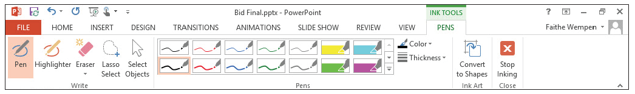
Step by Step: Edit Ink Annotations
Click the Ink Tools Pens tab to examine the options available (see the figure below).
Click the Color button to open its palette, and click Light Green. The selected annotation changes color.

Slide 60
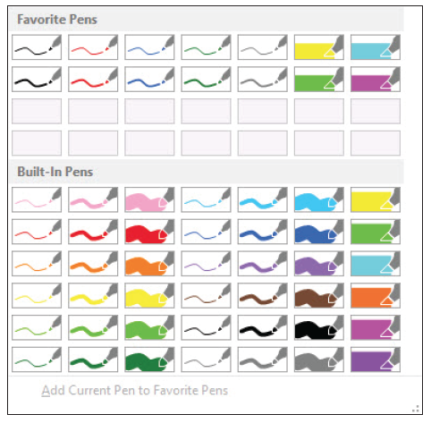
Step by Step: Edit Ink Annotations
Click the Thickness button to open its menu, and click 3 pt. The selected annotation increases in thickness.
Click the More button in the Pens group to open a gallery of pen styles (see the figure at right).

Slide 61
Step by Step: Edit Ink Annotations
In the Built-In Pens section, click Red Pen (1.0 mm).
Notice that the selected annotation does not change. These pen styles are for creating new annotations, not editing existing ones.
Drag to draw an underline beneath Site Preparation.
On the Ink Tools Pens tab, click the Select Objects button to return to using the arrow pointer again.
SAVE the presentation.
PAUSE. LEAVE the presentation open to use in the next exercise.

Slide 62
Step by Step: Present Online
USE the Bid Final presentation that is still open from the previous exercise.
If you do not have a Microsoft ID, go to www.live.com and get one.
In PowerPoint, on the Slide Show tab, click Present Online. The Present Online dialog box opens.
Notes:
Take Note: You must have a Windows Live ID to broadcast a presentation using the Online Presentation Service.

Slide 63
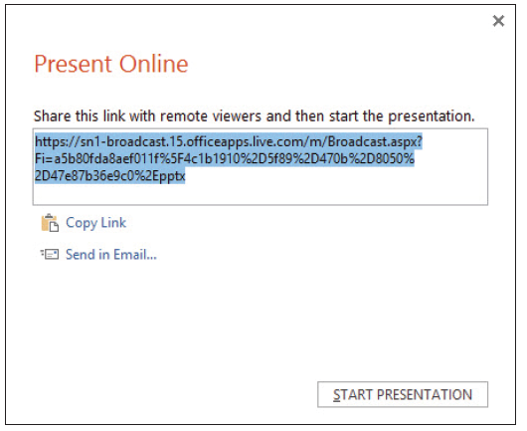
Step by Step: Present Online
Click Connect. If prompted to sign in with your Micro- soft ID, do so. After a short wait, a link appears that you can share with audience members (see the figure at right). The link you receive will be different from the one shown.
(Optional) If you know people who want to see your broadcast, give them the link.

Slide 64
Step by Step: Present Online
You can do this by clicking Send in Email and emailing them the link, or by distributing the link in some other method, such as manually writing it down on paper. You do not have to have any audience members in order to practice broadcasting, however.
Click Start Presentation. The slide show opens in Slide Show view. You are now broadcasting.
Notes:
Take Note: To see how a broadcast presentation looks when viewed remotely, team up with a classmate and take turns watching each other’s shows.

Slide 65
Step by Step: Present Online
Move through the presentation as you normally would. You can optionally use your microphone to comment on the slide content or read it aloud as you go.
When you reach the last slide, click one more time to exit, returning to Normal view.
On the Present Online tab, click End Online Presentation.
PAUSE. LEAVE the presentation open to use in the next exercise.

Slide 66
Step by Step: Package a Presentation for CD
USE the Bid Final presentation that is still open from the previous exercise.
Insert a blank writeable CD disc in your writeable CD drive. If an AutoPlay box pops up, close it.
Click the File tab, click Export, click Package Presentation for CD, and click Package for CD. The Package for CD dialog box opens.
Notes:
Take Note: You must have a writeable CD drive inserted in your system to complete this exercise. If you do not, or if you do not have a blank writeable CD disc available, skip this exercise.

Slide 67
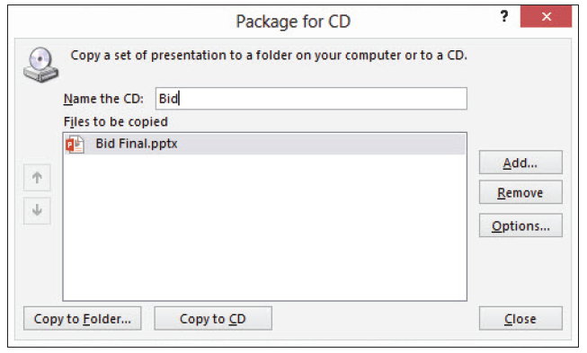
Step by Step: Package a Presentation for CD
In the Name the CD box, type Bid, replacing the default name (see the figure below).
Notes:
Take Note: You can optionally add other presentations onto the same CD to avoid using a separate CD for each presentation. To add other presentations, you would click Add and select the presentations to include. You could then reorder them with the up and down arrow buttons in the dialog box. This exercise packages only one presentation on CD, so it does not include these actions.

Slide 68
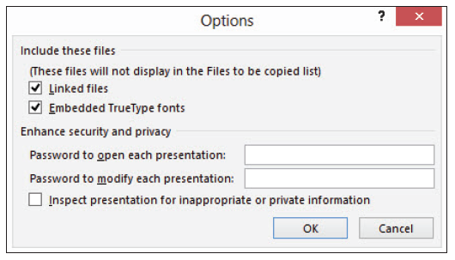
Step by Step: Package a Presentation for CD
Click the Options button. The Options dialog box opens. Note that linked files are marked to be included, and TrueType fonts will be embedded. Note that you can also optionally specify passwords to control access to the presentation(s) (see the figure below).

Slide 69
Step by Step: Package a Presentation for CD
Click OK to accept the default settings and close the Options dialog box.
In the Package for CD dialog box, click Copy to CD.
A dialog box asks if you want to include linked files in your package. Click Yes.
A message appears that the presentation contains comments or annotations, stating that these will not be included. Click Continue.

Slide 70
Step by Step: Package a Presentation for CD
Wait for the presentation to be written to the CD. It may take several minutes. The CD ejects when finished.
In PowerPoint, a message appears stating that the files were successfully copied to CD and offering to copy the same files to another CD. Click No.
Click Close to close the Package for CD dialog box.
To test your new CD, reinsert the CD into your computer. If an Auto Play box opens, click Run PresentationPackage.html. If no box opens, open File Explorer (or Windows Explorer if using Windows 7), click Computer, and double-click the CD drive.

Slide 71
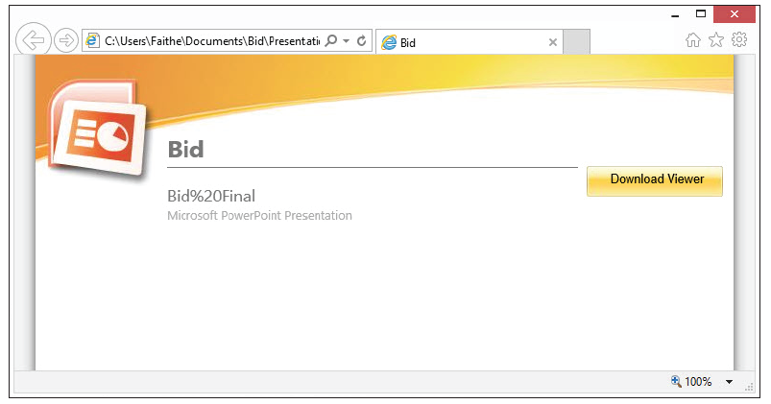
Step by Step: Package a Presentation for CD
A Web page displays, showing a page that lists the presentations on the CD. (There is only one in this case.) (see the figure below). A link also appears for downloading the PowerPoint Viewer. You do not need it on your PC since you have the full version of PowerPoint.
Notes:
Take Note: Note that the name appears as Bid%20Final, because the space between the two words is treated as a non-breaking space in HTML.

Slide 72
Step by Step: Package a Presentation for CD
Click the name of the presentation (Bid%20Final). Respond to any security warnings you might see in your Web browser. The presentation opens in PowerPoint, in Protected View.
Click the File tab and click Close to close the copy of the presentation that originated from the CD. (The original Bid Final presentation is still open.)
PAUSE. LEAVE the presentation open to use in the next exercise.

Slide 73
Step by Step: Package a Presentation to a Folder
USE the Bid Final presentation that is still open from the previous exercise.
Click the File tab, click Export, click Package Presentation for CD, and click Package for CD. The Package for CD dialog box opens.
Click Copy to Folder. The Copy to Folder dialog box opens.
In the Folder name box, change the default name to Bid Proposal.

Slide 74
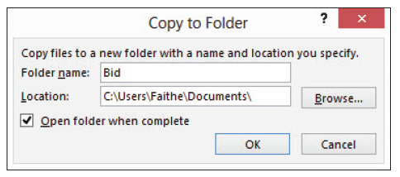
Step by Step: Package a Presentation to a Folder
In the Location box, change the path to the location where you store files for this lesson (see the figure below).
Click OK.
A message appears asking if you want to include linked files in your package. Click Yes.

Slide 75
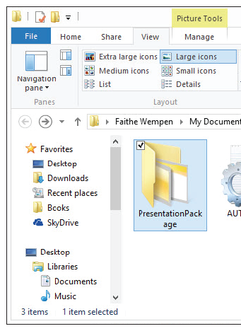
Step by Step: Package a Presentation to a Folder
A message appears that the presentation contains comments or annotations, and that these will not be included. Click Continue.
Wait for the presentation to be written to the new folder. It should occur almost instantaneously (unlike when making a CD). The folder opens in Windows when it is finished (see the figure at right).

Slide 76
Step by Step: Package a Presentation to a Folder
In the folder window, double-click the PresentationPackage folder to see what is inside it. The folder contains some graphics and support files that are needed to show the Web page.
Close the folder window and return to PowerPoint. The Package for CD dialog box is still open.
Click Close to close the dialog box.
SAVE the presentation and then CLOSE the file.
EXIT PowerPoint.

Slide 77
Skill Summary

